Slide 1
Guided By
Miss Supriya Jadhav
senior data scientist
Ex. Serviceman
Bhutan Football Club
Presented By Group 2
BIPAN GHALLEY
TSHEWANG SAMTEN
DORJIYE WANGMO

Slide 2

Content
Home page Team wise Dashboard Technologies used

Slide 3
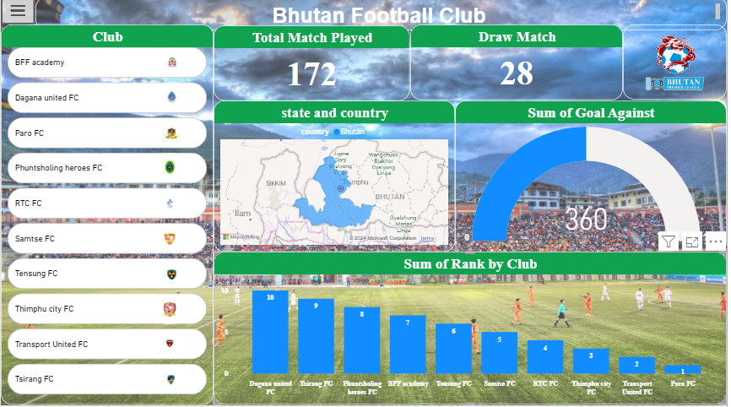
Home Page

Slide 4
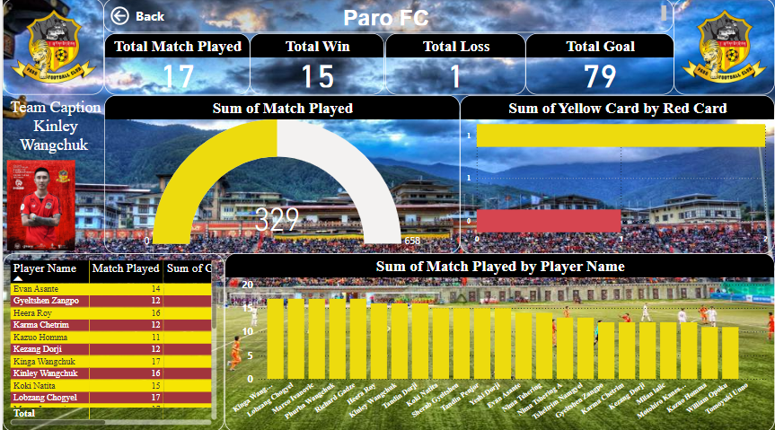
TOP PERFORMING TEAM

Slide 5
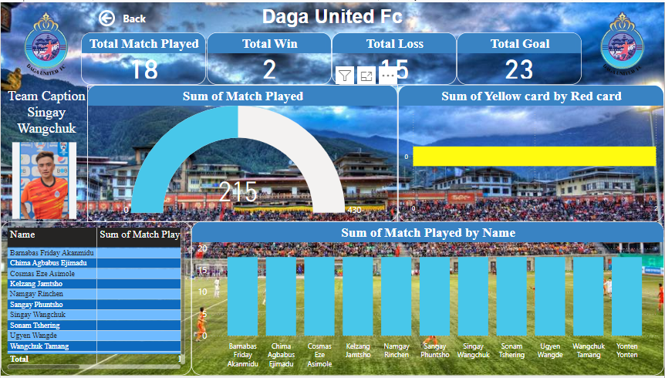
BOTTOM PERFORMING TEAM

Slide 6
TECHNOLOGIES USED
CARD
BUTTON
Drill THROUGH
BOOKMARKED
MAPPING
TABLE
SLICER
DIFFERENT TYPE OF CHARTS

Slide 7
Thank You
Open for Question?

